Slide 1
SELF PRESENTATION
BY FOUZIA IMRAN

Slide 2
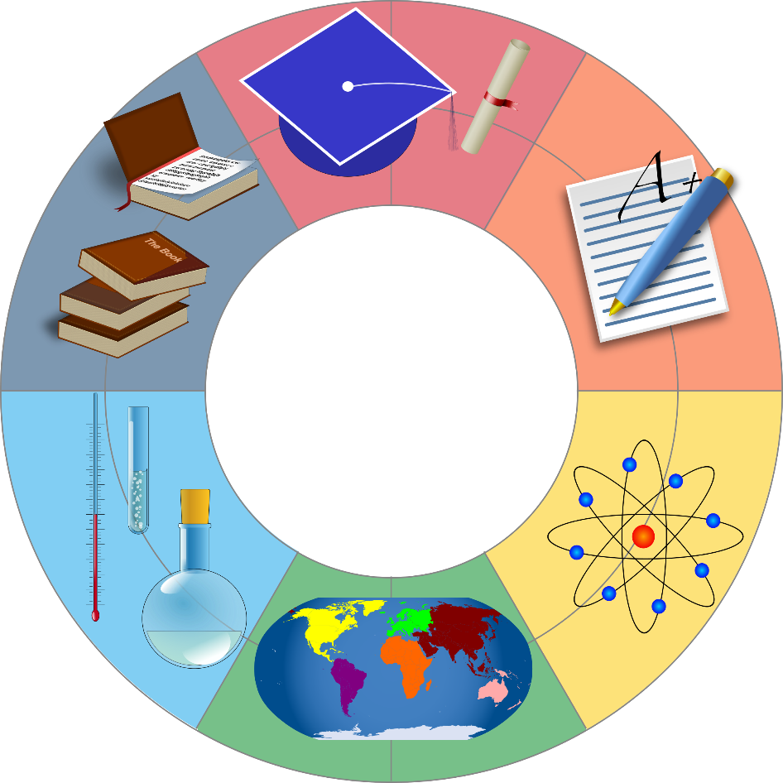
INTRODUCTION
I am Fouzia Imran.
Married and blessed with three children.
Pursuing BA studies at BBSU .

Slide 3
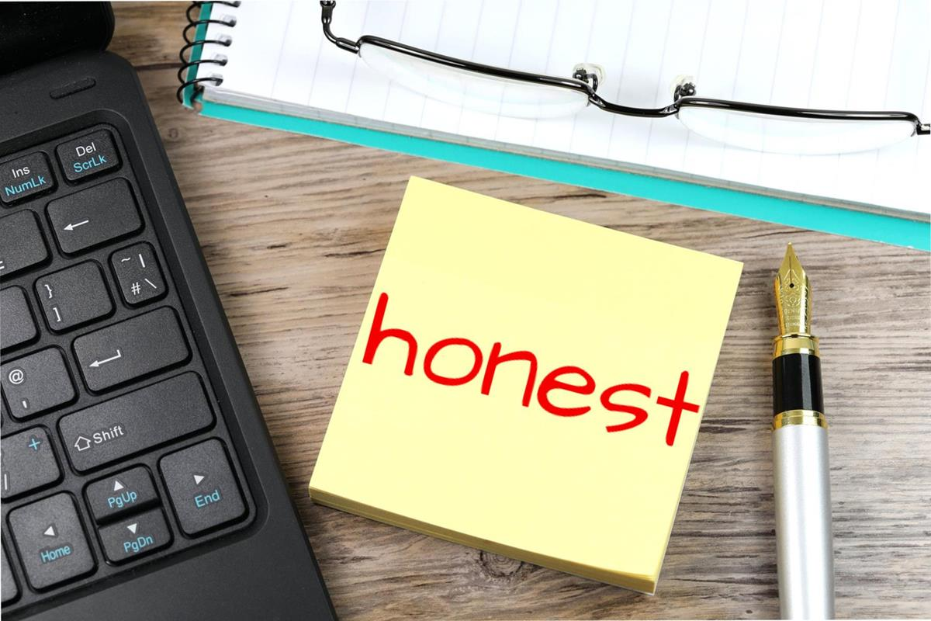

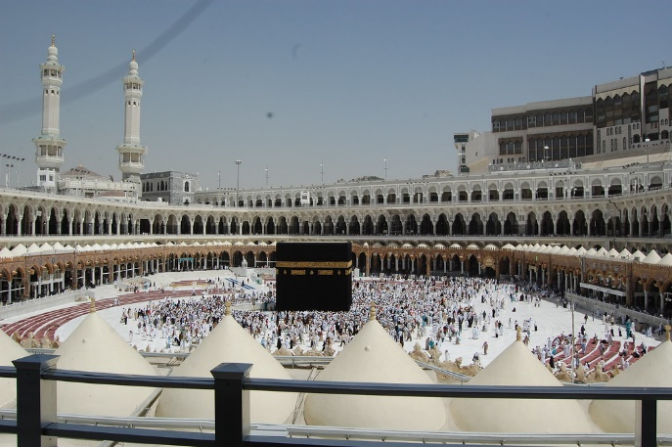
PERSONALITY TRAITS
Honest and hard working. .
Passionate about continuous learning.
Deep interest in Deen e Islam .

Slide 4
HOBBIES AND INTEREST
Collecting information on HAJJ and UMRAH.
Gardening - Taking care of plants
Reading Islamic books

Slide 5

ACHIEVEMENTS
Resumed studies after marriage.
Achieved Top rank in EDP course from CERD.
Successfully completed MS office from BANO QABIL.
Alhamdulillah balanced family life while continuing education.

Slide 6
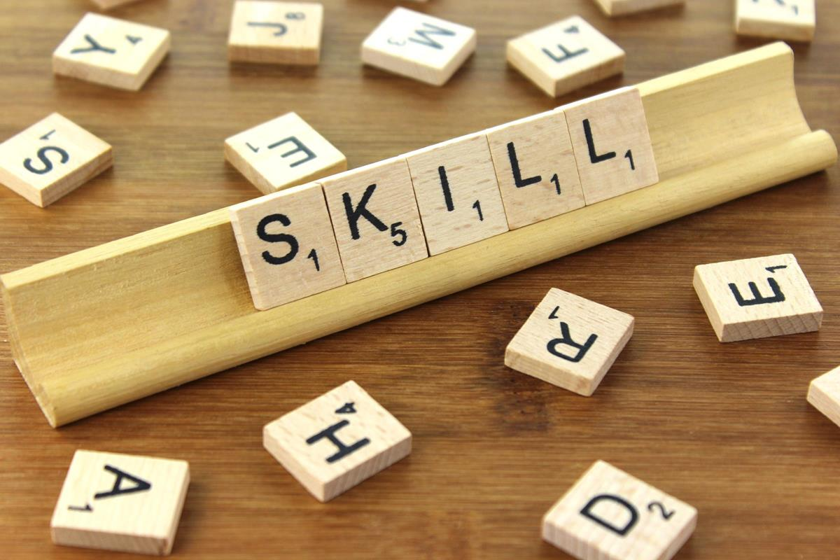
SKILLS LEARNED
MS OFFICE
COMMUNICATION SKILL
STITCHING
TUTORING
MEHANDI ART
GRAPHIC DESIGNING
PROBLEM SOLVING
This Photo by Unknown Author is licensed under CC BY-SA

Slide 7
FAVOURITE TOPIC ,TOOL
SMART ART
EYE DROPPER
TABLE FORMATTING
for easy and stylish visual presentation.
Best for color selection & matching.
Makes data clear and professional.

Slide 8
STRENGTH
NEVER STOP LEARNING
My biggest strength is that I never stop learning .
HARD WORKING & DEDICATED
Always complete tasks with full effort.
CONNECTED WITH ISLAM
Follow Islamic values and teach them to children.
weaknesses
OVER THINKING
Sometimes spend too much time on small details.
PERFECTIONIST NATURE
Want everythink perfect , which may delay task.
POOR TIME MANAGEMENT
Some time difficultyin managing time effectively.

Slide 9
FUTURE GOALS
Complete my education successfully.
Establish a quality school,because school is like a “mini society”
Provide good education to my children and help them become better human beings
Work with Jamaat-e-Islami for the betterment of society
EDUCATION
SCHOOL PROJECT
PARENTING
SOCIAL WORK

Slide 10
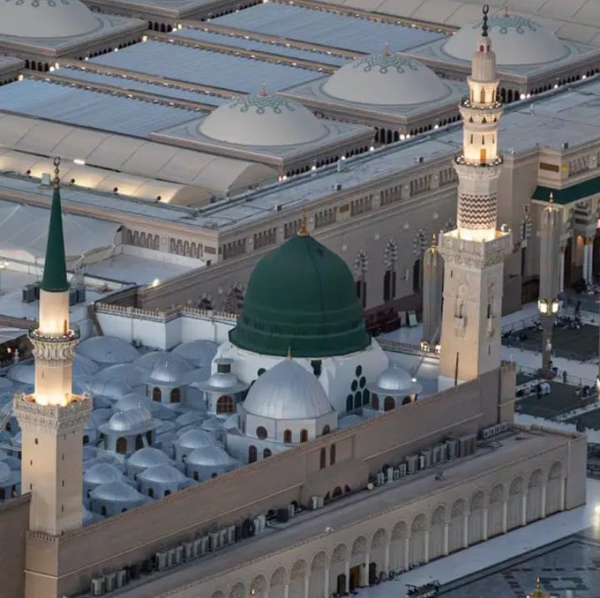
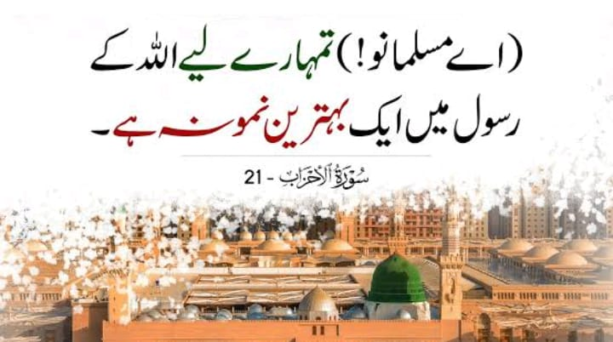
ROLE MODEL
“ MY ROLE MODEL IS PROPHET
MUHAMMAD (S.A.W.W)”
AND I AM INSPIRED BY THE
SEERAT OF PROPHET
MUHAMMAD (S.A.W.W)

Slide 11
THANK YOU
“A TEACHER INFLUENCES MORE LIVES IN A DAY THAN MANY PEOPLE DO IN A LIFETIME”

